Slide 1
Systematic Theology 3
Session 3
Professor Frank D. Macchia

Slide 2
Bondage of the Will
¹⁴ We know that the law is spiritual; but I am unspiritual, sold as a slave to sin. ¹⁵ I do not understand what I do. For what I want to do I do not do, but what I hate I do. ¹⁶ And if I do what I do not want to do, I agree that the law is good… ²¹ So I find this law at work: Although I want to do good, evil is right there with me. ²² For in my inner being I delight in God’s law; ²³ but I see another law at work in me, waging war against the law of my mind and making me a prisoner of the law of sin at work within me. ²⁴ What a wretched man I am! Who will rescue me from this body that is subject to death? ²⁵ Thanks be to God, who delivers me through Jesus Christ our Lord!

Slide 3
Prevenient Grace
And he made from one man every nation of mankind to live on all the face of the earth, having determined allotted periods (Kairos) and the boundaries of their dwelling place, ²⁷ that they should seek God, and perhaps feel their way toward him and find him. Yet he is actually not far from each one of us, ²⁸ for
“‘In him we live and move and have our being’;
as even some of your own poets have said,
“‘For we are indeed his offspring.’ (Acts 17:26-28).

Slide 4
Justification by grace through faith
Therefore, since we have been justified through faith, we have peace with God through our Lord Jesus Christ, ² through whom we have gained access by faith into this grace in which we now stand. And we boast in the hope of the glory of God (Rom. 5:1).
Catholic –
Accepted of God by grace through faith but justification is fulfilled in our graced growth in righteousness by works.
Luther – accepted by grace through faith alone.
Diet of Regensburg (1541)

Slide 5
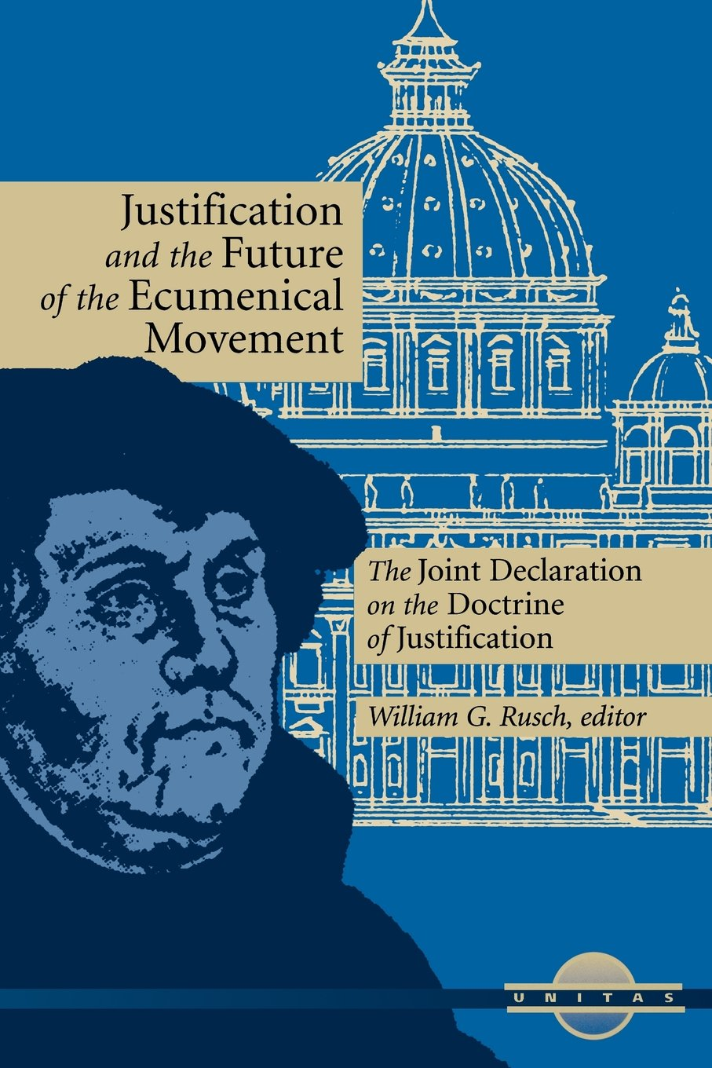
Joint Declaration on the doctrine of Justification
“In faith we together hold the conviction that justification is the work of the triune God. The Father sent his Son into the world to save sinners. The foundation and presupposition of justification is the incarnation, death, and resurrection of Christ. Justification thus means that Christ himself is our righteousness, in which we share through the Holy Spirit in accord with the will of the Father. Together we confess: By grace alone, in faith in Christ’s saving work and not because of any merit on our part, we are accepted by God and receive the Holy Spirit, who renews our hearts while equipping and calling us to good work” (#15).

Slide 6
Paul: Faith alone
If, in fact, Abraham was justified by works, he had something to boast about—but not before God. ³ What does Scripture say? “Abraham believed God, and it was credited to him as righteousness.”
⁴ Now to the one who works, wages are not credited as a gift but as an obligation. ⁵ However, to the one who does not work but trusts God who justifies the ungodly, their faith is credited as righteousness (Rom. 4:1-4).

Slide 7
James: By faith and works
What good is it, my brothers and sisters, if someone claims to have faith but has no deeds? Can such faith save them? (James 2:14).
But someone will say, “You have faith; I have deeds.” Show me your faith without deeds, and I will show you my faith by my deeds. ¹⁹ You believe that there is one God. Good! Even the demons believe that—and shudder (James 2:18-19).
And the scripture was fulfilled that says, “Abraham believed God, and it was credited to him as righteousness,” and he was called God’s friend. ²⁴ You see that a person is considered righteous by what they do and not by faith alone (James 2:23-24).
He chose to give us birth through the word of truth, that we might be a kind of firstfruits of all he created (James 1:18).

Slide 8
We are God’s good work!
For it is by grace you have been saved, through faith—and this is not from yourselves, it is the gift of God— ⁹ not by works, so that no one can boast. ¹⁰ For we are God’s handiwork, created in Christ Jesus to do good works, which God prepared in advance for us to do (Eph. 2:8-10).
A flourishing life

Slide 9
Regeneration
And you were dead in the trespasses and sins ² in which you once walked, following the course of this world, following the prince of the power of the air, the spirit that is now at work in the sons of disobedience— ³ among whom we all once lived in the passions of our flesh, carrying out the desires of the flesh and the mind, and were by nature children of wrath, like the rest of mankind. ⁴ But God, being rich in mercy, because of the great love with which he loved us, ⁵ even when we were dead in our trespasses, made us alive together with Christ—by grace you have been saved— ⁶ and raised us up with him and seated us with him in the heavenly places in Christ Jesus (Eph. 2:1-6).
Everyone who believes that Jesus is the Christ has been born of God, and everyone who loves the Father loves whoever has been born of him (1 John 5:1).

Slide 10
Sanctification - Resurrection
¹⁶ But I say, walk by the Spirit, and you will not gratify the desires of the flesh. ¹⁷ For the desires of the flesh are against the Spirit, and the desires of the Spirit are against the flesh, for these are opposed to each other, to keep you from doing the things you want to do. ¹⁸ But if you are led by the Spirit, you are not under the law (Gal. 5:16-18).
…and was declared to be the Son of God in power according to the Spirit of holiness by his resurrection from the dead, Jesus Christ our Lord (Rom. 1:4).
And not only the creation, but we ourselves, who have the firstfruits of the Spirit, groan inwardly as we wait eagerly for adoption as sons, the redemption of our bodies (Rom. 8:23).
For while we are still in this tent, we groan, being burdened—not that we would be unclothed, but that we would be further clothed, so that what is mortal may be swallowed up by life. ⁵ He who has prepared us for this very thing is God, who has given us the Spirit as a guarantee (2 Cor. 5:4).

Slide 11
The Church: The Elect People
Election in the Old Testament:
1) Occurs in time involving Abraham …and especially Moses & the Exodus:
“I swear by myself, declares the Lord, that because you have done this and have not withheld your son, your only son, ¹⁷ I will surely bless you and make your descendants as numerous as the stars in the sky and as the sand on the seashore. Your descendants will take possession of the cities of their enemies, ¹⁸ and through your offspring all nations on earth will be blessed, because you have obeyed me” (Gen. 22:16-18).

Slide 12
Church: Elect to be Sons and Daughters
When Israel was a child, I loved him,
and out of Egypt I called my son.
² The more they were called,
the more they went away;
they kept sacrificing to the Baals
and burning offerings to idols.
And Mary said to the angel, “How will this be, since I am a virgin?”
³⁵ And the angel answered her, “The Holy Spirit will come upon you, and the power of the Most High will overshadow you; therefore the child to be born will be called holy—the Son of God (Luke 1:34-35).

Slide 13
Sons and Daughters
And the Holy Spirit descended on him in bodily form, like a dove; and a voice came from heaven, “You are my beloved Son;^{[a]} with you I am well pleased” (Luke 3:22).
I myself did not know him, but he who sent me to baptize with water said to me, ‘He on whom you see the Spirit descend and remain, this is he who baptizes with the Holy Spirit.’ ³⁴ And I have seen and have borne witness that this is the Chosen One.”
…and was declared to be the Son of God in power according to the Spirit of holiness by his resurrection from the dead, Jesus Christ our Lord (Rom. 1:4).

Slide 14
Elect as Sons and Daughters
For you did not receive the spirit of slavery to fall back into fear, but you have received the Spirit of adoption as sons, by whom we cry, “Abba! Father!” (Rom. 8:15).
For it was fitting that he, for whom and by whom all things exist, in bringing many sons to glory, should make the founder of their salvation perfect through suffering. ¹¹ For he who sanctifies and those who are sanctified all have one source. That is why he is not ashamed to call them brothers (Heb. 2:10-11).

Slide 15
Elect humanity
Then the Lord God formed a man from the dust of the ground and breathed into his nostrils the breath of life, and the man became a living being (Gen. 2:7).
When I consider your heavens,
the work of your fingers,
the moon and the stars,
which you have set in place,
⁴ what is mankind that you are mindful of them,
human beings that you care for them?
⁵ You have made them a little lower than the angels
and crowned them with glory and honor.
⁶ You made them rulers over the works of your hands;
you put everything under their feet (Psalm 8:3-6).

Slide 16
Elect Humanity
And so from this one man, and he as good as dead, came descendants as numerous as the stars in the sky and as countless as the sand on the seashore.
¹³ All these people were still living by faith when they died. They did not receive the things promised; they only saw them and welcomed them from a distance, admitting that they were foreigners and strangers on earth. ¹⁴ People who say such things show that they are looking for a country of their own. ¹⁵ If they had been thinking of the country they had left, they would have had opportunity to return. ¹⁶ Instead, they were longing for a better country—a heavenly one. Therefore God is not ashamed to be called their God, for he has prepared a city for them (Heb. 11:12-16).

Slide 17
Elect Humanity
²⁶ From one man he made all the nations, that they should inhabit the whole earth; and he marked out their appointed times in history and the boundaries of their lands. ²⁷ God did this so that they would seek him and perhaps reach out for him and find him, though he is not far from any one of us. ²⁸ ‘For in him we live and move and have our being.’ As some of your own poets have said, ‘We are his offspring’ (Acts 17:26-28).
The first man was of the dust of the earth; the second man is of heaven. ⁴⁸ As was the earthly man, so are those who are of the earth; and as is the heavenly man, so also are those who are of heaven. ⁴⁹ And just as we have borne the image of the earthly man, so shall we bear the image of the heavenly man (1 Cor. 15:48-49).

